Slide 1
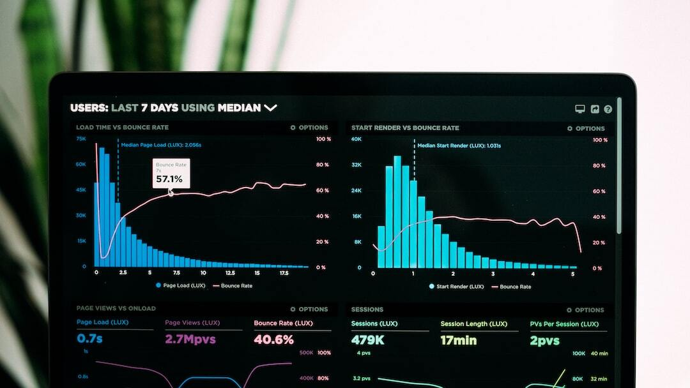
Kaggle Competition: Predicting Abalone Ages
Presenter: Cole Barsun
Date: [April 25th]
Photo by Luke Chesser on Unsplash

Slide 2

Project Summary
Objective: Predict abalone ages using regression analysis.
Methods: Employ exploratory data analysis, preprocessing, and feature engineering.
Models Tested: Linear Regression, Random Forest, Gradient Boosting.
Success Measure: Minimize Root Mean Squared Logarithmic Error (RMSLE).
Photo by Isaac Smith on Unsplash

Slide 3

Problem Statement
Problem Defined: Developing a machine learning model to predict the age of abalones from physical attributes.
Importance: Accurate age prediction is crucial for sustainable fisheries management and ecological research.
Benchmark Model: The benchmark model is linear regression.
Dataset Characteristics: Characterization of the dataset used in the model development.
Photo by Marco Topete on Unsplash

Slide 4
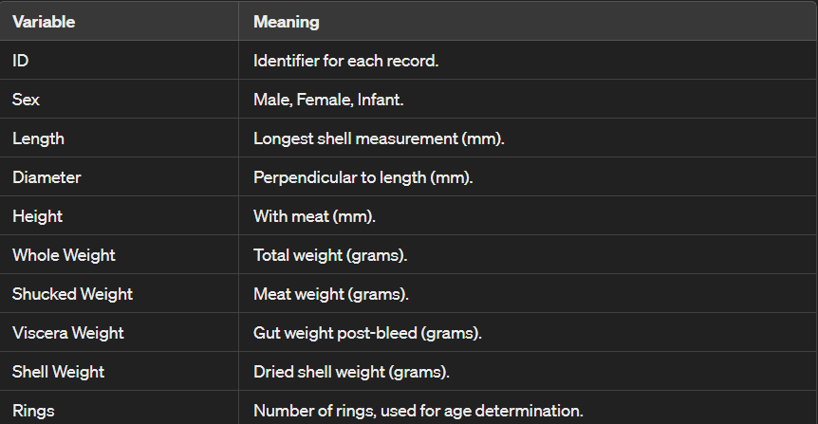
Dataset Overview
Dataset Composition: Training Dataset: Instances: 90,615, Attributes: 10 Testing Dataset: Instances: 60,411, Attributes: 9 Total Entries: 151,026
Description: Physical measurements of abalones from marine research databases for age prediction.
Benchmarks: 10% of data reserved as a validation set to benchmark the baseline model (linear regression) against advanced models.

Slide 5

Exploratory Data Analysis (EDA)
Visualizations Used: Histograms, Box Plots, Scatter Plots, and Correlation Heatmaps.
Key Insights: Analysis revealed patterns, relationships, and potential outliers within the dataset.
Purpose of EDA: To understand data distributions and underlying relationships to guide further analysis and model building.
Photo by Cường Bùi Huy on Unsplash

Slide 6
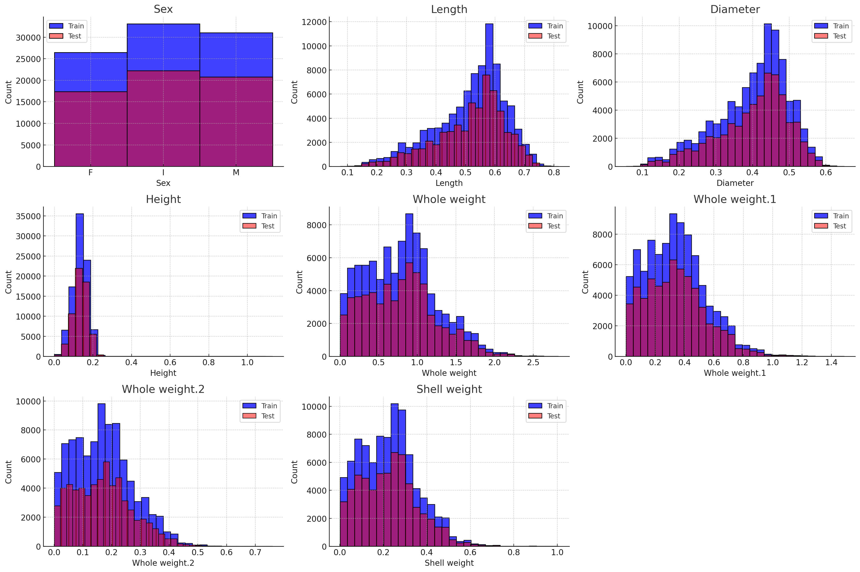
Histograms
I used Histograms to view the distribution of each numerical variable such as length, diameter, height, and various weights.
These plots help identify the range, central tendency, skewness, and presence of outliers in the data

Slide 7
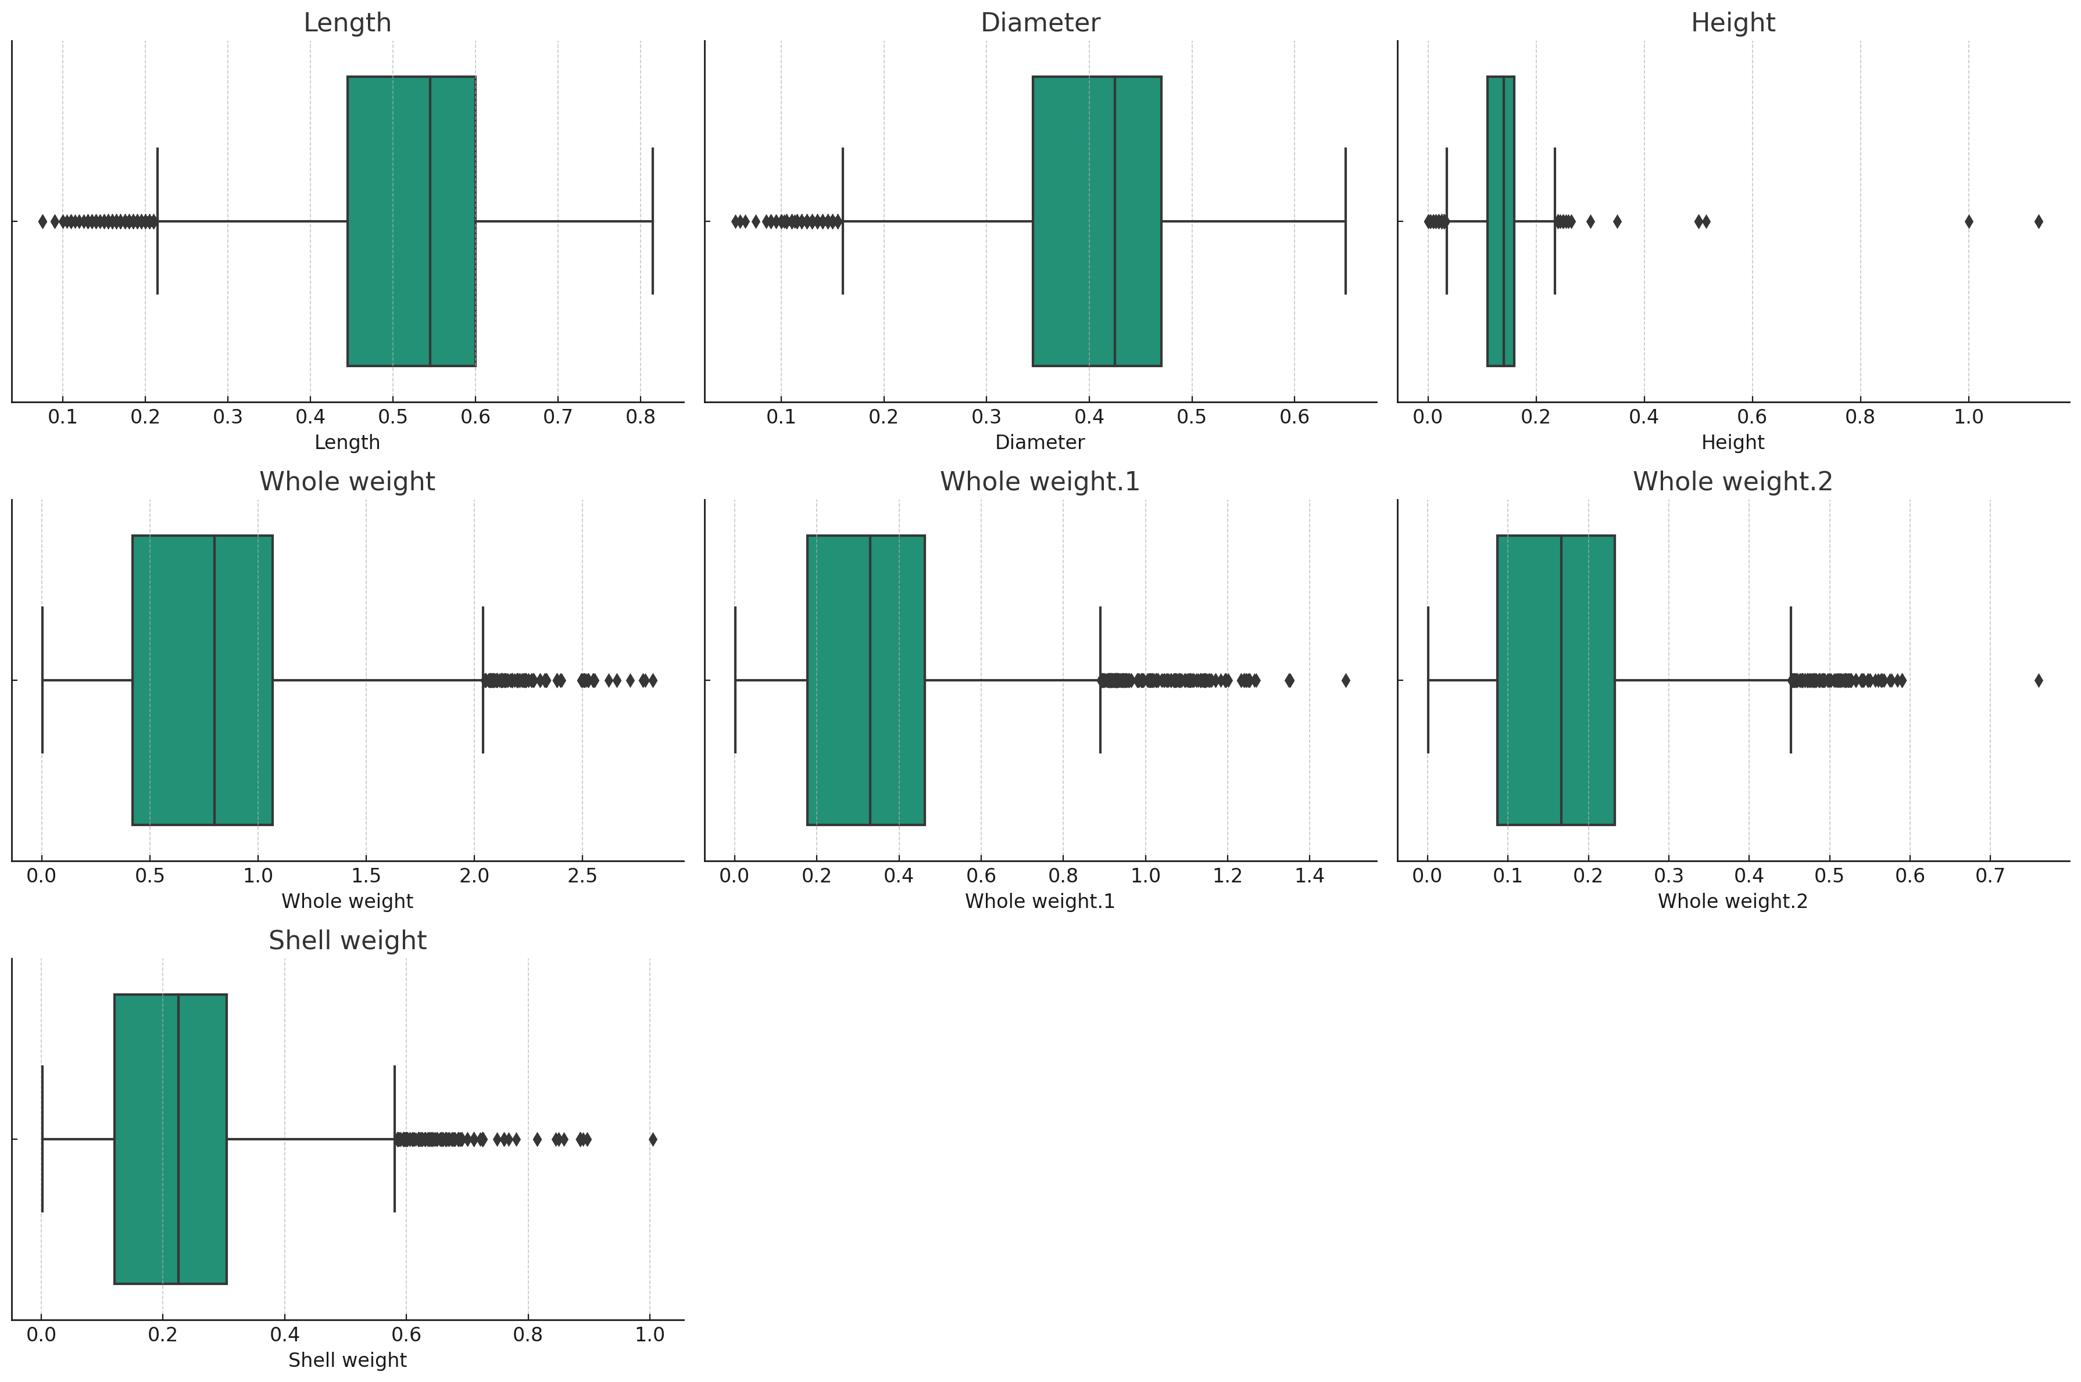
Box Plots
To visualize the spread and centers of numerical variables
Importantly, to spot outliers

Slide 8
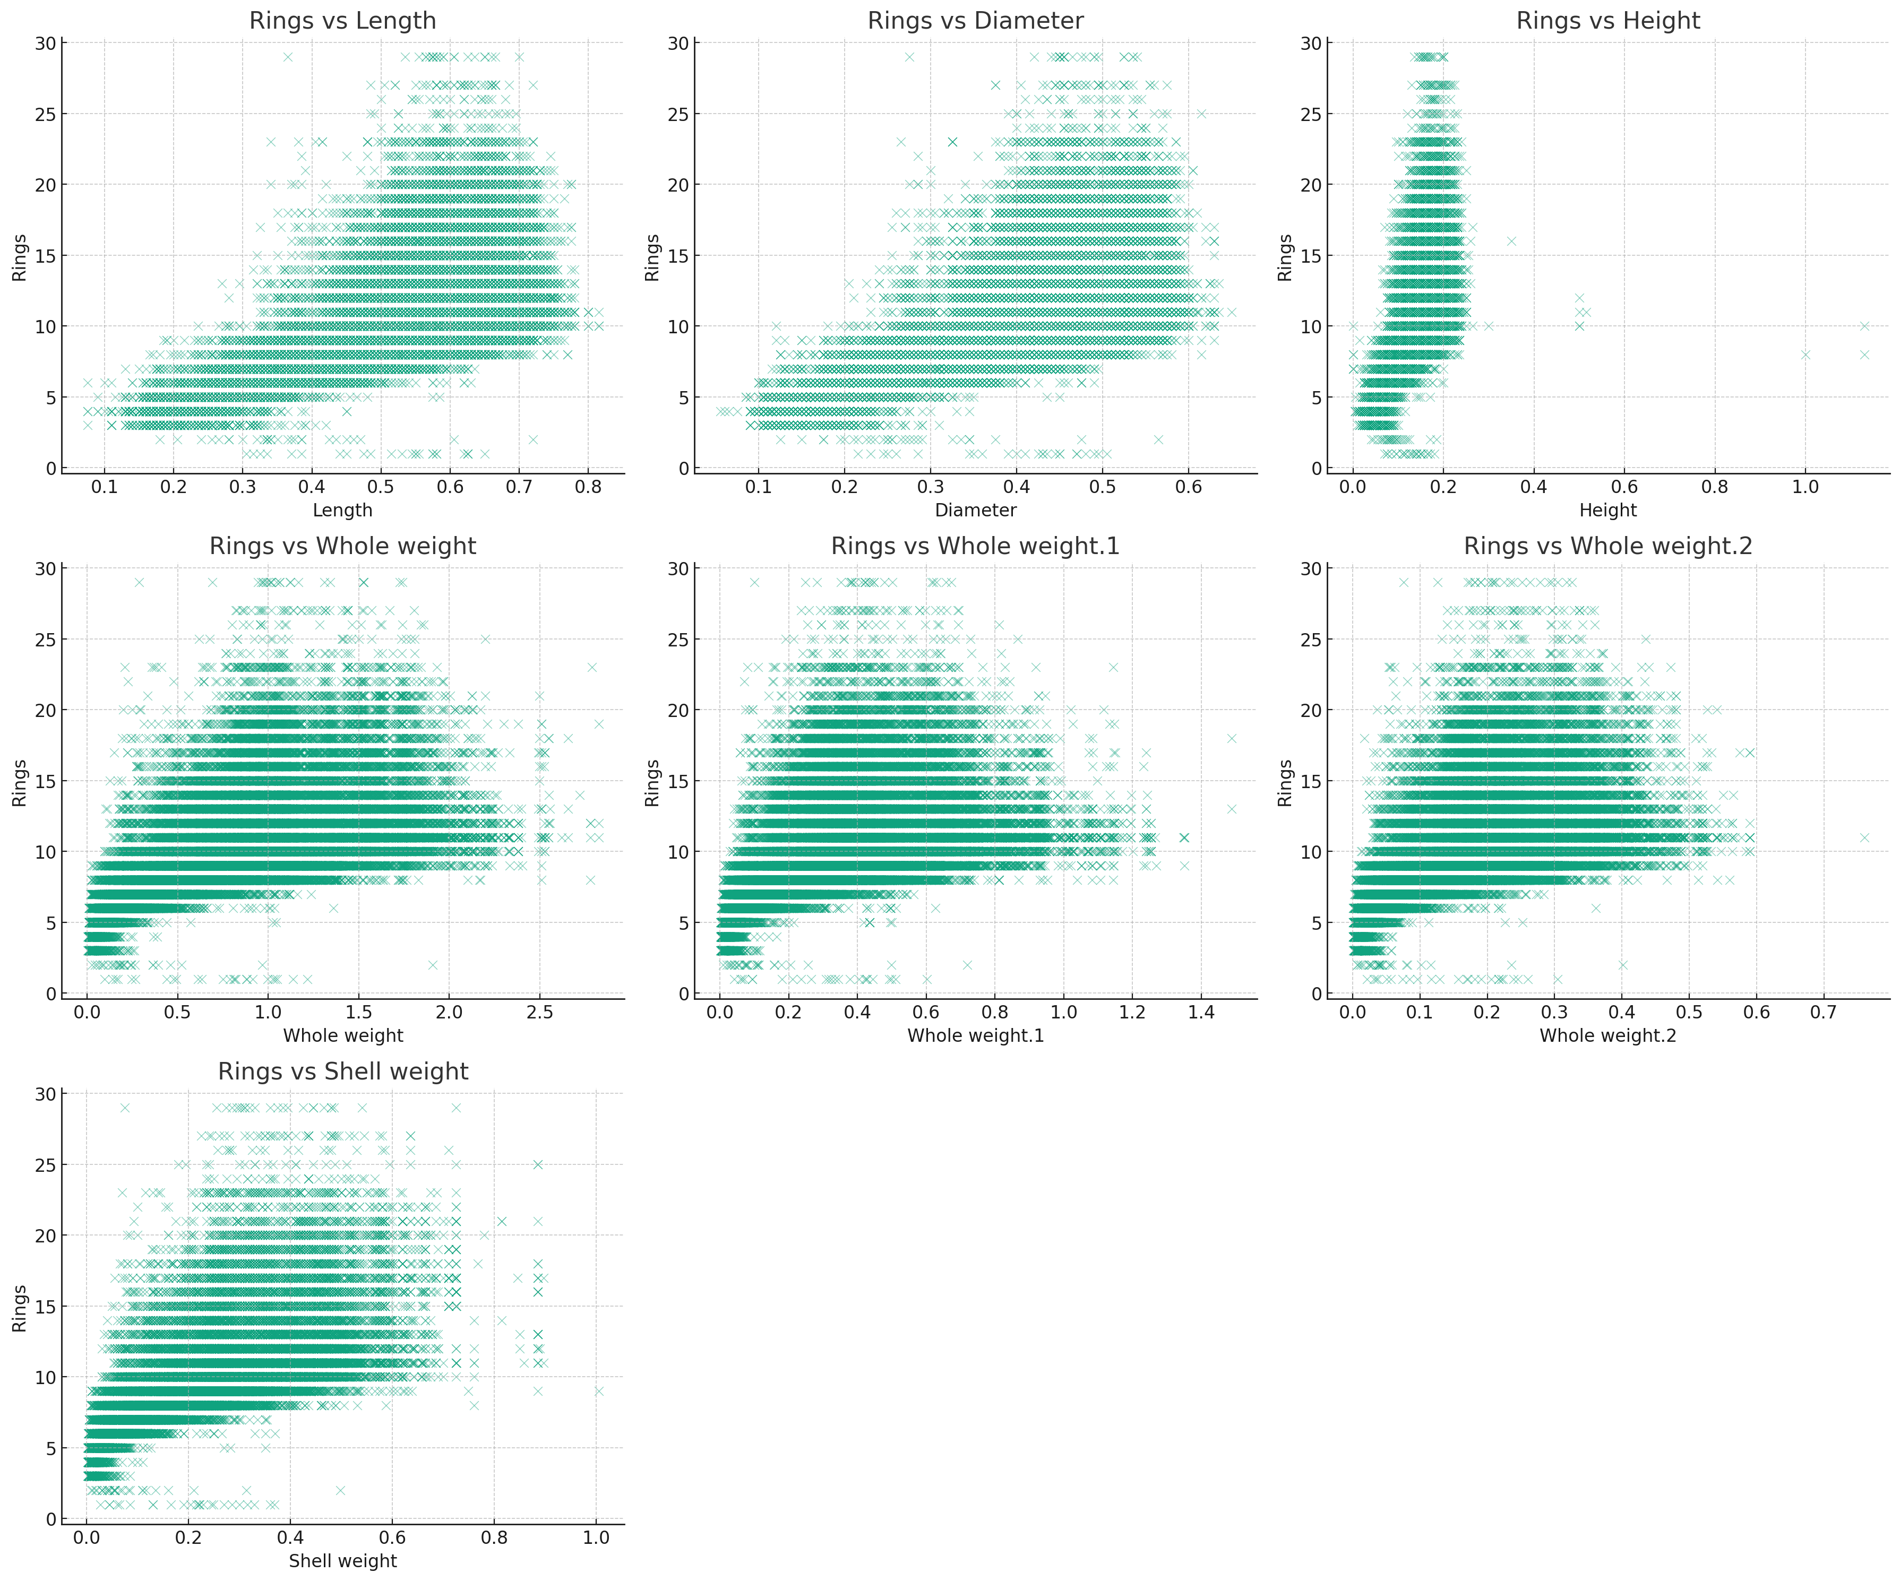
Scatter Plots
I used scatter plots to examine the relationship between the number of rings (age) and other measurements like length and weight.

Slide 9
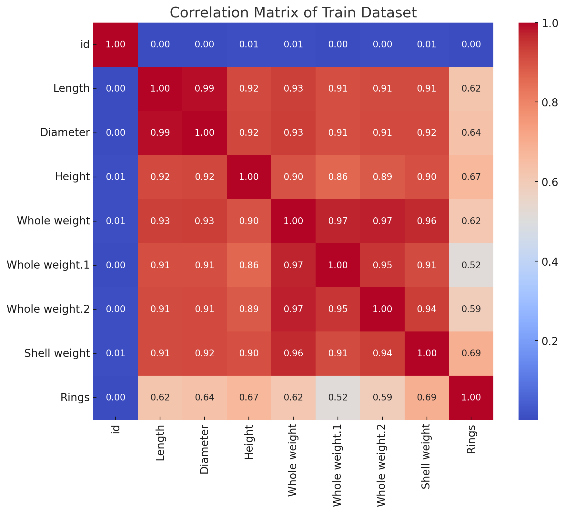
Correlation Heatmap
Lastly, I used a correlation heatmap to assess the degree of correlation between all numerical variables, particularly how they relate to the number of rings.

Slide 10
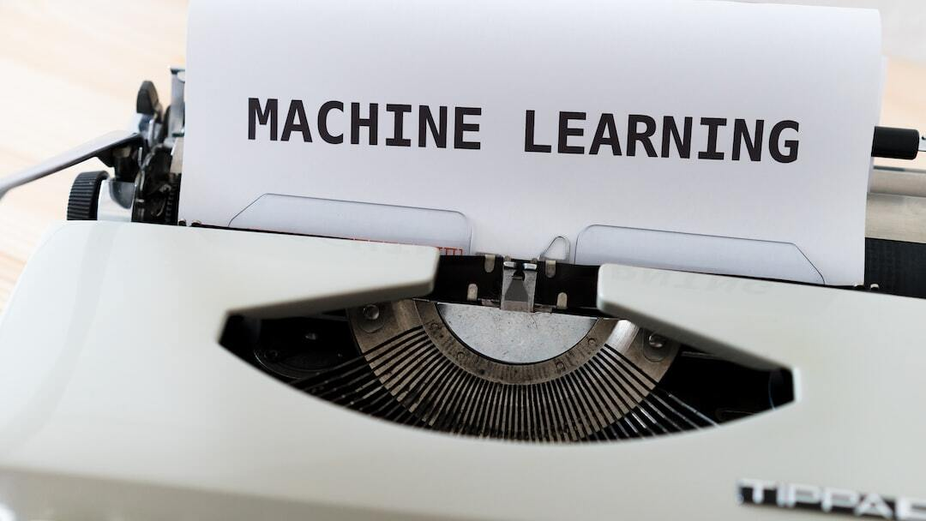
Data Preprocessing
Handling Outliers: Techniques applied to mitigate the impact of outliers on model accuracy.
Scaling Features: Feature scaling implemented to normalize data dimensions for better model performance.
Encoding Categorical Data: Categorical variables were encoded to facilitate model processing.
Technique Selection Rationale: Selection based on the specific needs of the dataset and predictive modeling requirements.
I did not choose to use certain feature selection techniques, as well as advanced non-linear models
Photo by Markus Winkler on Unsplash

Slide 11
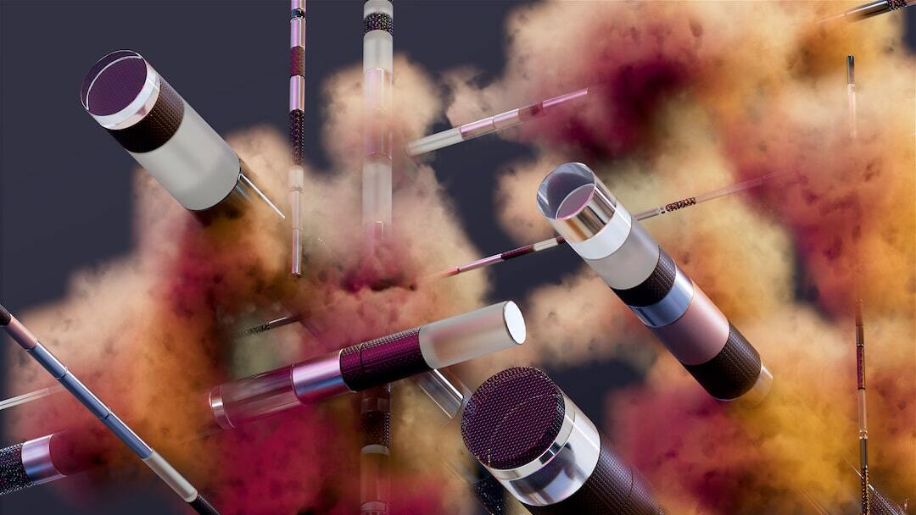
Machine Learning Approaches
Baseline Model Setup: The baseline evaluation setup in this project involved using a simple linear regression model as the initial benchmark. The evaluation metric I am using is Root Mean Squared Logarithmic Error (RMSLE)
Ensemble Methods: Focus on Random Forest and Gradient Boosting to enhance prediction accuracy.
Method Selection Rationale: Chosen for their robustness in handling diverse data and improving prediction over baseline.
Photo by DeepMind on Unsplash

Slide 12

Experiments and Results
Data Preprocessing Highlights
Verified zero missing values; no imputation required.
Corrected zero height measurements with median values to address inaccuracies.
Standardized numeric features using StandardScaler to prevent scale bias.
One-hot encoded 'Sex' variable for compatibility with model input.
Model Training & Evaluation Summary
Established a baseline with Simple Linear Regression.
Employed Random Forest for its balance of bias-variance; significantly improved RMSLE.
Utilized GBM for superior handling of non-linearities; slightly better RMSLE than Random Forest.
Photo by CoWomen on Unsplash

Slide 13
Experiments and Results – P2
Hyperparameter Tuning & Validation Takeaways
Conducted 5-fold cross-validation, confirming Random Forest’s stability and generalizability.
Optimized models using grid search; enhanced RMSLE through ideal parameter selection.
Key Experimental Insights
Identified shell weight and diameter as top predictors from Random Forest feature importance analysis.
GBM emerged as the leading model, showcasing its ability to capture complex data patterns.

Slide 14
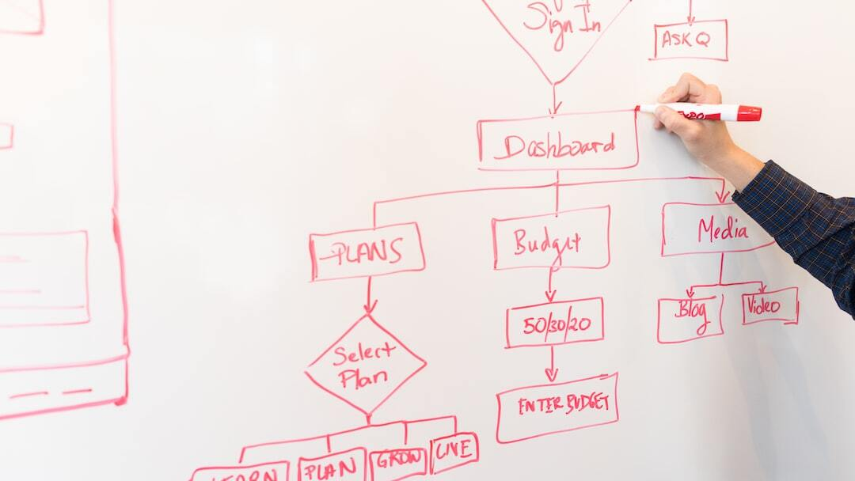
Conclusions and Future Work
Key Takeaways
High Accuracy Achieved: Our machine learning model, particularly the Gradient Boosting Machine (GBM), successfully minimized the Root Mean Squared Logarithmic Error (RMSLE), significantly outperforming the baseline model set by simple linear regression.
Importance of Feature Engineering: Extensive exploratory data analysis and feature engineering (including scaling and encoding) played a crucial role in improving model performance.
Robust Validation: Employing cross-validation ensured that our model was not only accurate but also robust, demonstrating consistent performance across different subsets of the data.
Photo by Christina @ wocintechchat.com on Unsplash

Slide 15
Conclusions and Future Work
Lessons Learned:
Balance in Model Complexity: Advanced models justified their computational cost by substantially improving performance.
Importance of Iterative Refinement: Continuous model tuning and validation were essential in optimizing performance.
Future Improvements:
Expand Dataset: More data could further refine and strengthen the model’s predictions.
Advanced Feature Selection: Employing sophisticated feature selection methods to improve efficiency.
Explore New Models: Testing alternative algorithms, including deep learning, to explore potential gains in accuracy.
Real-world Application: Deploy the model in practical settings to validate effectiveness and gather iterative feedback.

